Slide 1
Crop Health Assistant using Aritficial intelligence
By Sowmya shree,rishitha,sushma

Slide 2
ARTIFICIAL INTELLIGENCE
Artificial Intelligence is an approach to make a computer, a robot, or a product to think how smart human think. AI is a study of how human brain think, learn, decide and work, when it tries to solve problems. And finally this study outputs intelligent software systems.The aim of AI is to improve computer functions which are related to human knowledge, for example, reasoning, learning, and problem-solving. The objectives of AI research are reasoning, knowledge representation, planning, learning, natural language processing, realization, and ability to move and manipulate objects. There are long-term goals in the general intelligence sector.

Slide 3
Convolution neural network
A convolutional neural network (CNN) is a type of artificial neural network used in image recognition and processing that is specifically designed to process pixel data. CNNs are powerful image processing, artificial intelligence (AI) that use deep learning to perform both generative and descriptive tasks, often using machine vison that includes image and video recognition, along with recommender systems and natural language processing (NLP).

Slide 4
A CNN uses a system much like a multilayer perceptron that has been designed for reduced processing requirements.
The layers of a CNN consist of an input layer, an output layer and a hidden layer that includes multiple convolutional layers, pooling layers, fully connected layers and normalization layers.
The removal of limitations and increase in efficiency for image processing results in a system that is far more effective, simpler to trains limited for image processing and natural language processing.
The layers of neurons are arranged in such a way as to cover the entire visual field avoiding the piecemeal image processing problem of traditional neural networks.

Slide 5
Natural Language Processing
Natural Language Processing (NLP) refers to AI method of communicating with an intelligent systems using a natural language such as English.
Processing of Natural Language is required when you want an intelligent system like robot to perform as per your instructions, when you want to hear decision from a dialogue based clinical expert system, etc.
The field of NLP involves making computers to perform useful tasks with the natural languages humans use. The input and output of an NLP system can be −
Speech
Written Text

Slide 6
Image Propcessing in Arificial Intelligence
Generally speaking, image processing is manipulating an image in order to enhance it or extract information from it. There are two types of imageprocessing methods:
Analog image processing, which is used for processing photographs, printouts, and other hard copies of images
Digital image processing, which is used for manipulating digital images with the help of computer algorithms
In both cases, the input is an image. For analog image processing, the output is always an image. For digital image processing, however, the output may be an image or some features and characteristics associated with that image.

Slide 7
Dataset
DATASET | NO OF FOLDERS | TOTAL NO OF IMAGES
Training dataset | 5 | 493
Test dataset | 5 | 116

Slide 8
Crop health harvesting
This project is done my image processing algorithm using convolution neural network.In this the health of the crop is predicted using image processing .Here there are 5 types of diseases in the rice crop
1.bacterial leaf blight
2.blast
3.false smut
4.rice tungro
5.sheath blight

Slide 9
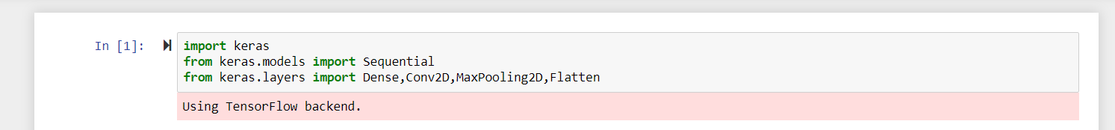
The first step is to import libraries.
Here we imported keras because keras is used as an image classifier.
Then we used sequential because the sequential API allows you to create models layer-by-layer for most problems. It is limited in that it does not allow you to create models that share layers or have multiple inputs or outputs.

Slide 10
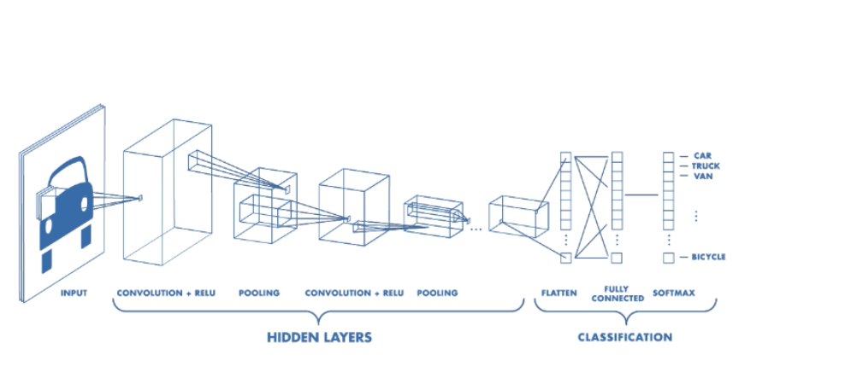

Slide 11
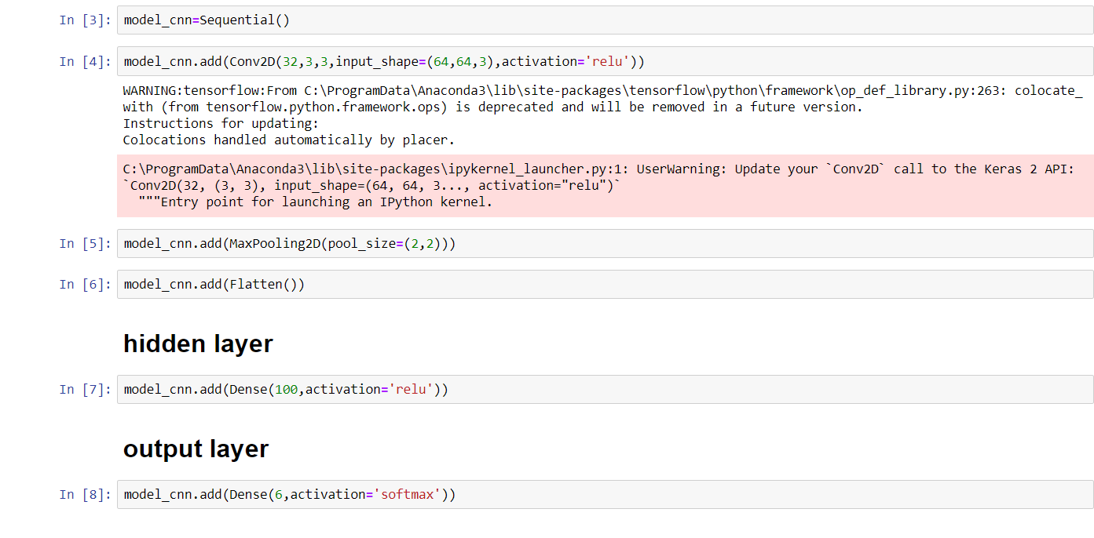
-- Now we do the hidden layers and classification according to the above diagram

Slide 12
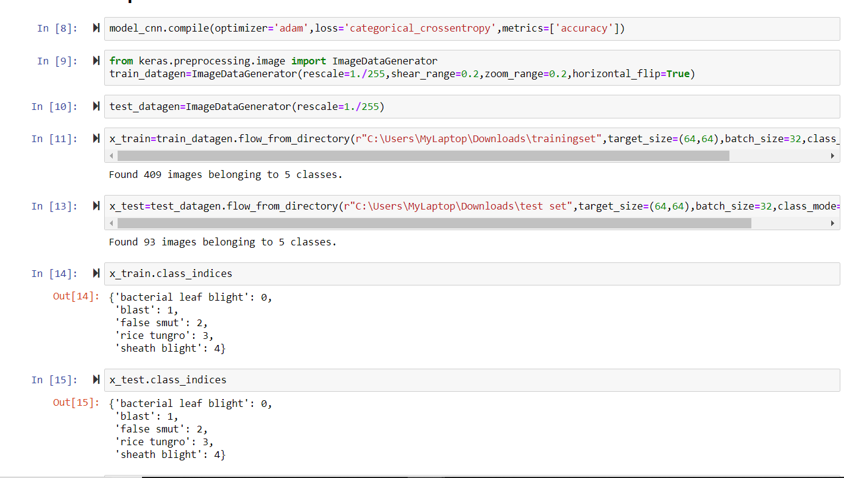
Here we train and test the dataset by specifying the path

Slide 13
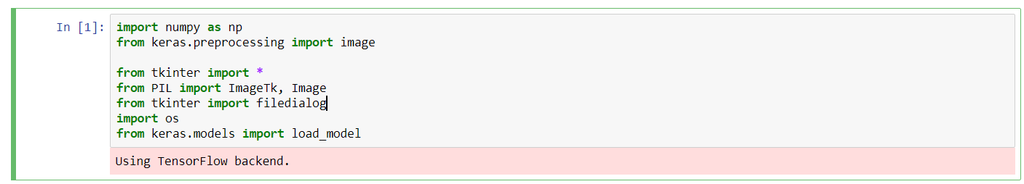
Now using tkinter we get the ui i.e we do prediction
Tkinter provides various controls, such as buttons, labels and text boxes used in a GUI application. These controls are commonly called widgets. The Button widget is used to display buttons in your application. The Canvas widget is used to draw shapes, such as lines, ovals, polygons and rectangles, in your application.

Slide 14
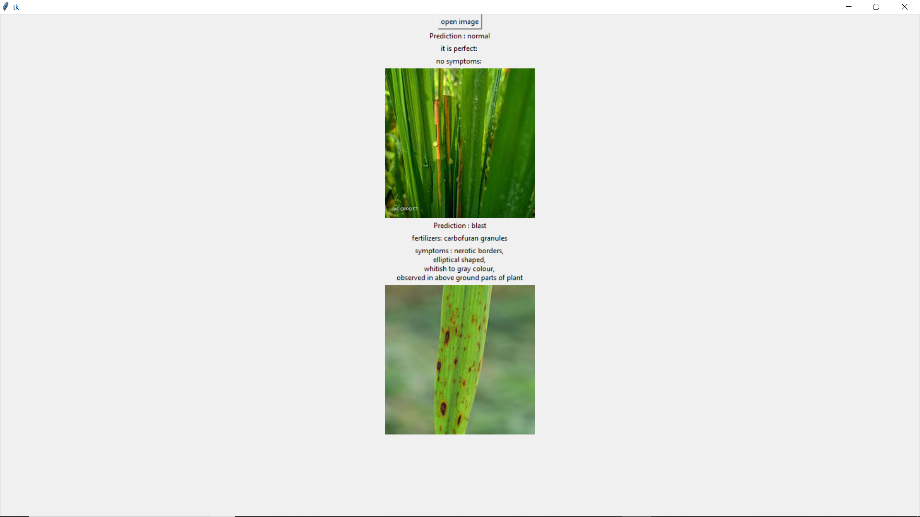
When ever the particular picture is given here the symptoms and the disesase name and particular fertilizer to be used is given
OUTPUT

Slide 15
THANKYOU

